Slide 1
ARTEMIS
Pouria Moradpour

Slide 2
PROBLEM
Currently, the electricity used by DataCenters is more than the national energy consumption of Iran, and it’s expected to grow 8 times by 2030.
The ravening consumption
Usage of fossil fuels
By the year 2030, 50% of the electricity is still produced using fossil fuels.
THE LARGE NUMBER OF DUPLICATED DATA
Around 50% to 80% of the data stored in various organizations, is duplicated.
Given this knowledge, the only practical way would be to detect and delete the duplicated data.

Slide 3
ARTEMIS, the most CLEVER soloution TO THis PROBLEM
when installled on a server, artemis automatically detects data that seems to be duplicated and sends them to our server,if we made sure that they are similar, our client deletes and free up the server space for you.

Slide 4
HOW ARTEMIS WORKS
artemis client
client detects potentially similar data just based on file type/size to decrease the load on your server*
the only thing your users might detect is that their media has better quality!
Your user
Your server
our client now sends the potentially similar data to our servers so we can make sure wether or not they’re similar
Our server
* you can schedule data detection so your users won’t observe any performance loss

Slide 5
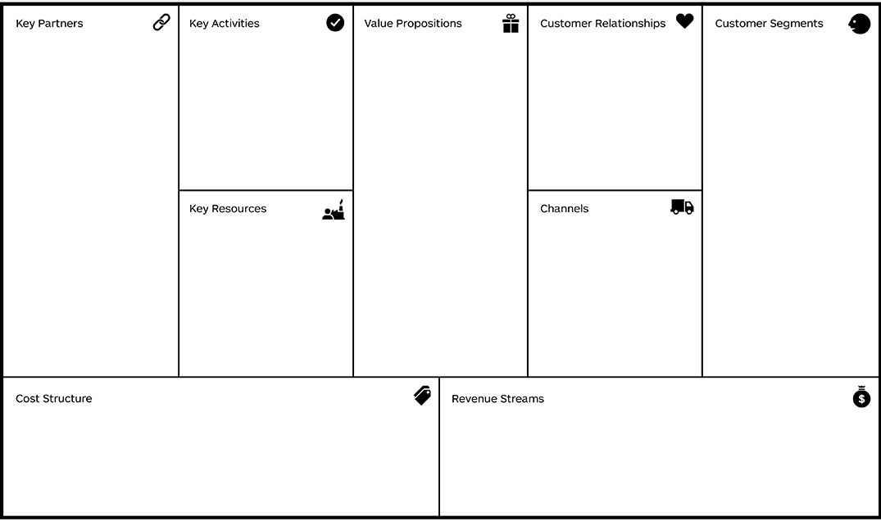
1-Data centers as customer or cloud sompution provider
2-Hardware companies
3-Environmental Organizations
Actively improving the client and AI
Freed up storage on the server which leads to:
1-cost savings due to less energy consumption
2-easier server management
3-cost savings due to less needed server storage
1-vairous discounts
For long term customers
2-24/7 customer suppport
1-organizations
2-social media
websites
3-data cneters
4-individuals*
1-Data scentists
2-Developers
3-Server to host our AI
4-Office for our engineers
1-Our website
2-Pages in social media
3-customer support

